Slide 1
Coca-Cola Stock Prediction & Strategy Comparison
Name – ABDULLAH MD SHAMIM
UNID: UMID17052536986
DATA SCIENCE INTERN
UNIFIED MENTORS

Slide 2
Project Objective
Predict Coca-Cola's future stock prices using historical data
Build & evaluate ML-based investment strategy
Compare ML strategy with Buy & Hold
Visualize trends and investment performance

Slide 3
Dataset Overview
Historical stock data (Yahoo Finance format)
- Coca-Cola_stock_history.csv
- Coca-Cola_stock_info.csv
Key columns: Open, High, Low, Close, Volume, Dividends, Stock Splits

Slide 4
Data Preprocessing
Convert 'Date' to datetime format
Sort data chronologically
Drop missing/null values
Reset index for proper modeling

Slide 5
Exploratory Data Analysis (EDA)
Statistical summary of prices
Close price trend visualization
20-day and 50-day Moving Averages
Volatility and daily return analysis

Slide 6
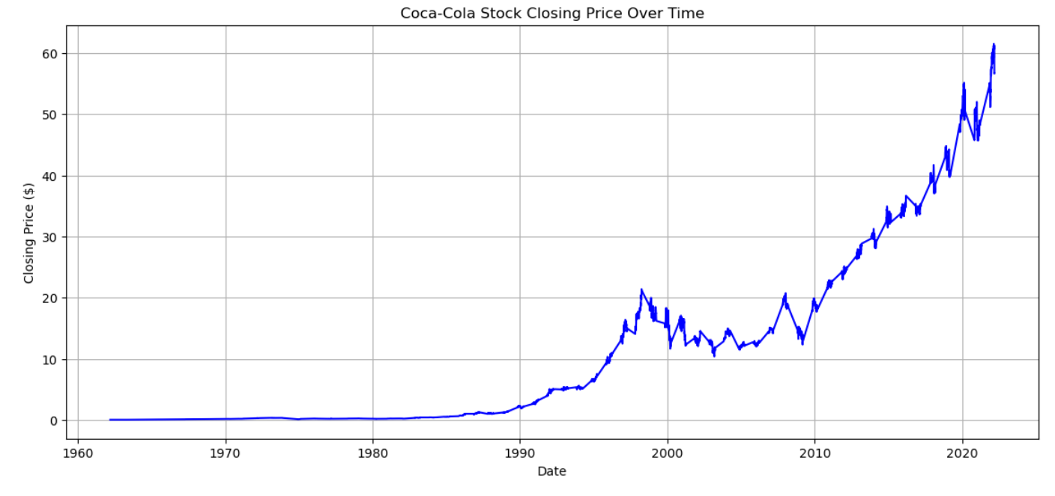
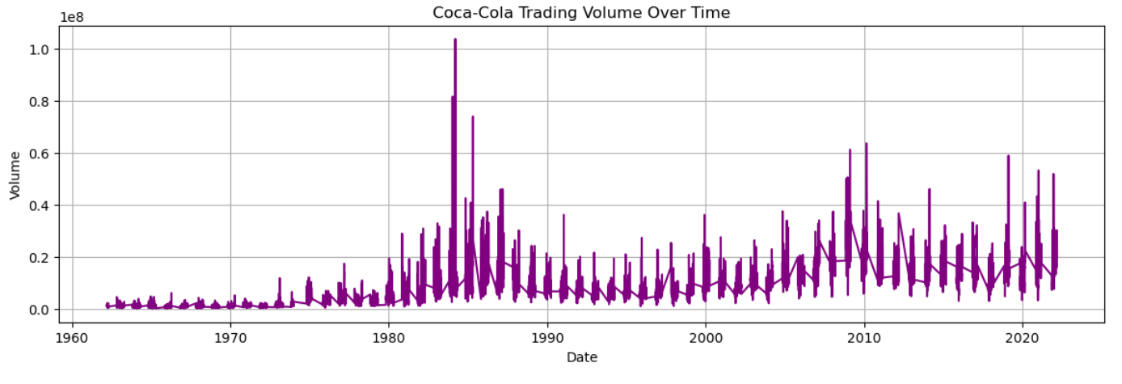

Slide 7
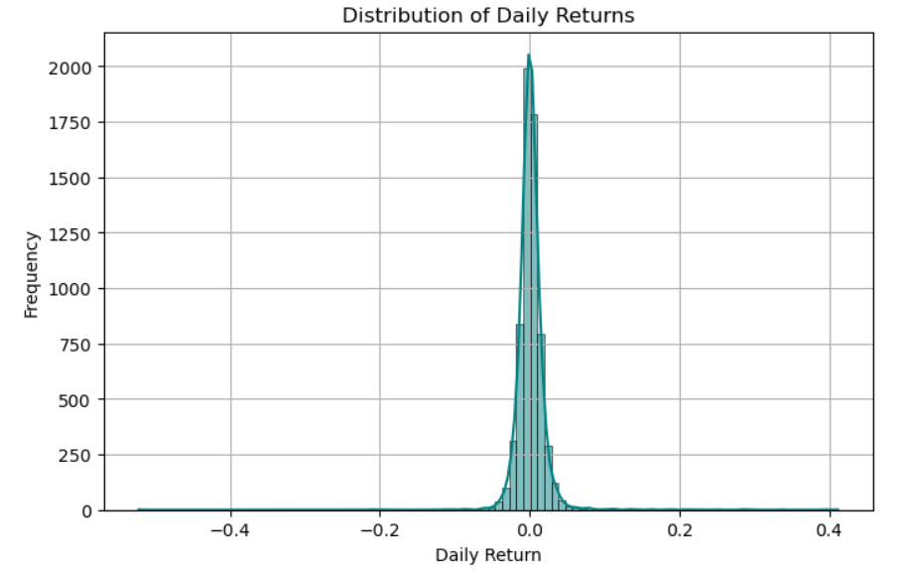
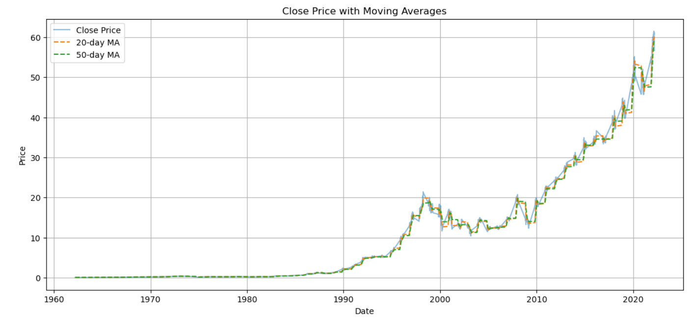

Slide 8
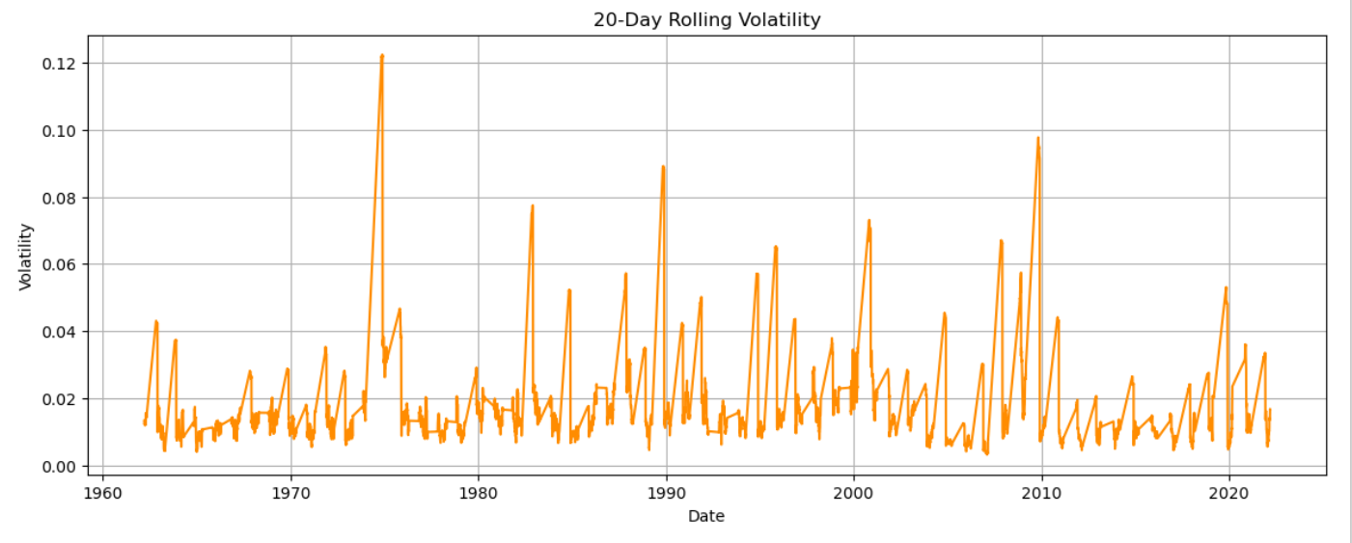

Slide 9
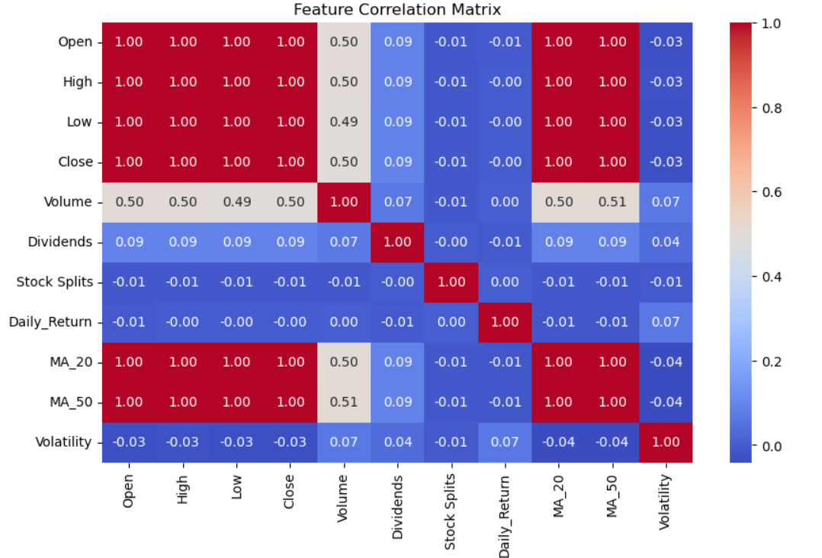

Slide 10
Feature Engineering
Added new features:
- 20-day & 50-day Moving Averages
- Daily Return (percentage change)
- 20-day Rolling Volatility
Enhanced input for model training

Slide 11
Model Training and Prediction
Model: RandomForestRegressor (Scikit-learn)
Features used: Price metrics + engineered features
Target variable: Close Price
Train-Test split (time-based, 80-20)

Slide 12
Strategy Comparison
Buy & Hold: Invest at start, hold till end
ML Strategy: Predict next-day price
- Buy if predicted > current close
- Stay in cash otherwise
Simulated both over full time period

Slide 13
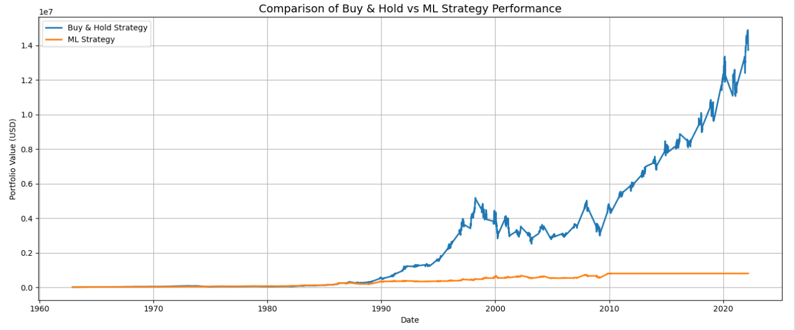

Slide 14
Results & Performance
Buy & Hold Final Value: $13,726,542.31
ML Strategy Final Value: $804,038.22
MAE: ~12.9 | MSE: ~297.2
ML strategy underperformed significantly

Slide 15
Conclusion & Learnings
ML models require tuning for financial use cases
Buy & Hold worked better for Coca-Cola
Predictions ≠ Profitable Trades
Next steps: Try LSTM, optimize trading logic, add Sharpe Ratio

Slide 16
Contact Info:
Name: Abdullah Md Shamim
Email: abdullahshamim7584@gmail.com
LinkedIn: https://www.linkedin.com/in/abdullah-shamim-497ba434a/

